Slide 1
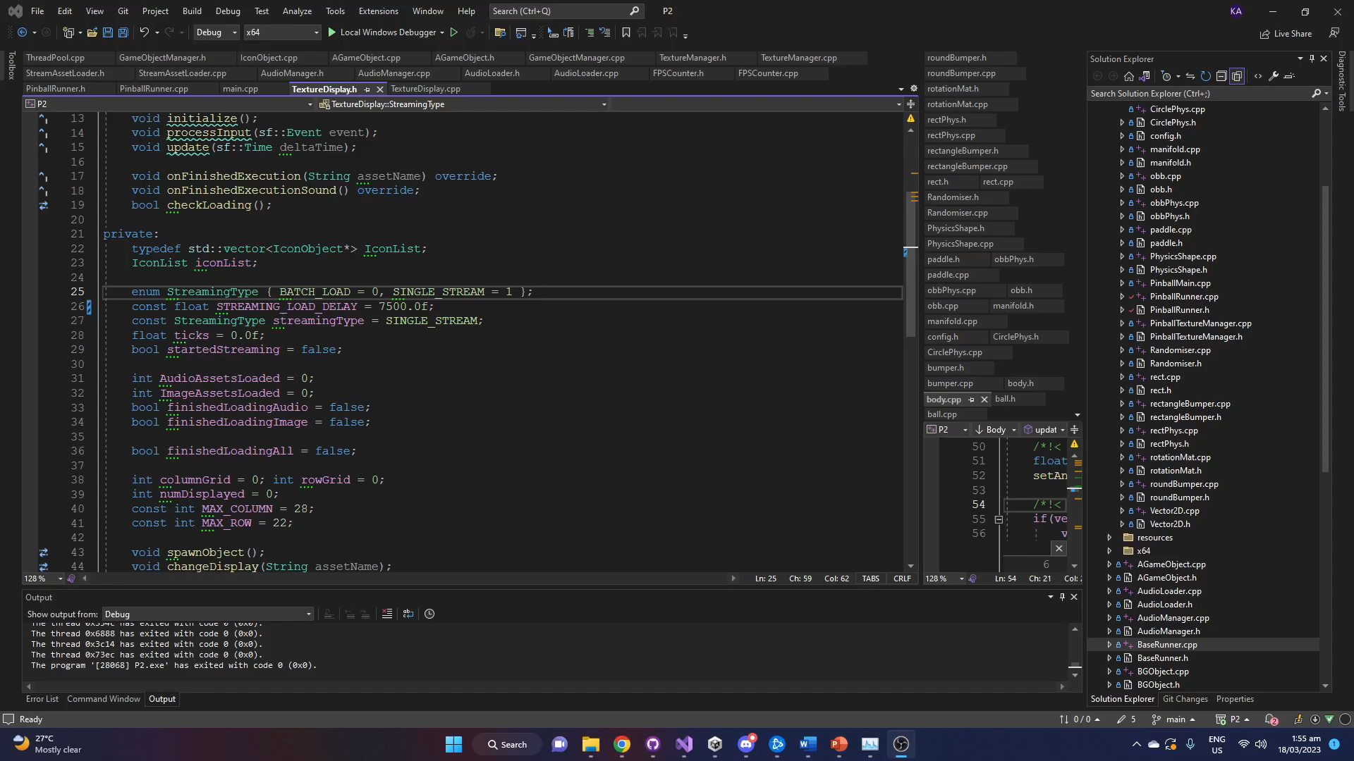

Slide 2
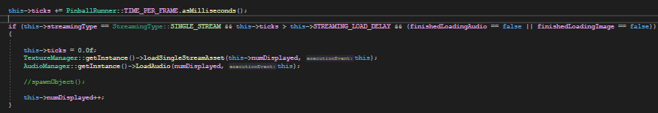
Every 7500 milliseconds, An audio asset and image asset load process are put into a queue
inside their respective managers. LoadSingleStreamAsset() and LoadAudio() are
Essentially the same, they just schedule different loading processes. The delay is there
To show the effects of multithreading and to avoid errors and bugs when loading assets
At the same time

Slide 3
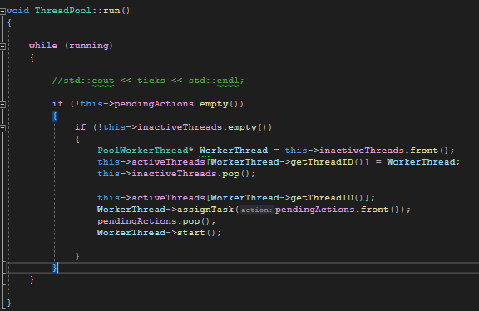
The AudioManager and TextureManager have their own ThreadPool which is responsible for handling the processes put into its queue. The numWorkers are the amount of threads the threadpool has which are then assigned to processes that it will execute.

Slide 4
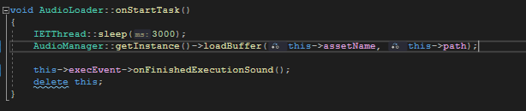
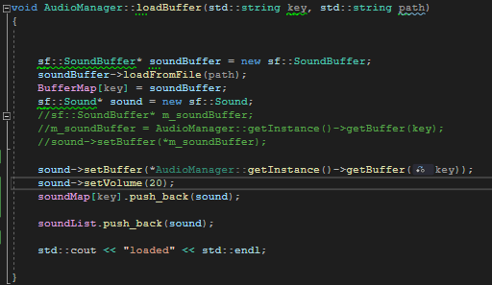
The workers assigned to work on a process on “AudioThread” will sleep for 3000 milliseconds to delay the thread. This is to simulate many large audio files being loaded, and prevent errors when accessing the LoadBuffer() function at the same time.

Slide 5
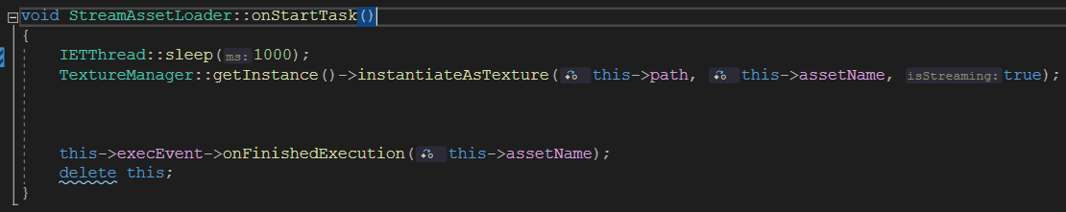
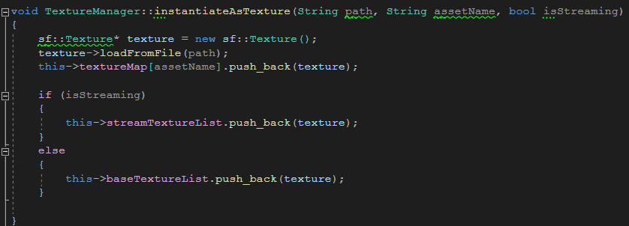
The “TextureThread” workers sleeps for 1000 milliseconds when doing its tasks. It has a shorter sleep time compared to the audio process to simulate the image files being a smaller size compared to the audio files.

Slide 6

The combined delays in the queueing up of tasks and starting of tasks is to ensure that FPS stays smooth while assets are being loaded into the background and to simulate loading assets with large sizes. Loading too much assets at once will split up the processing power of the cpu resulting in frame drops. 59-60 fps constant while running pinball is achieved by doing this

Slide 7
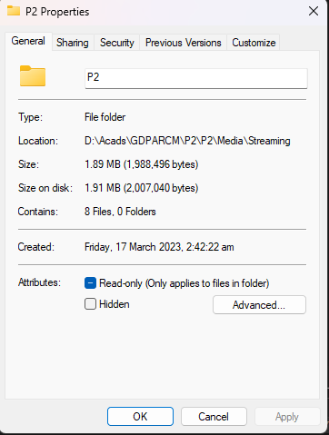

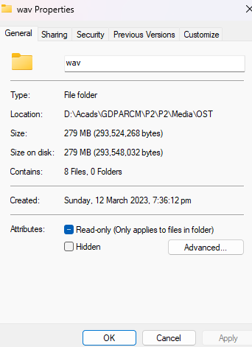
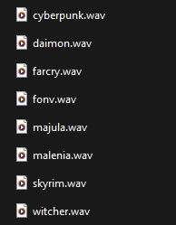
These are the assets that are being loaded in the background.

Slide 8
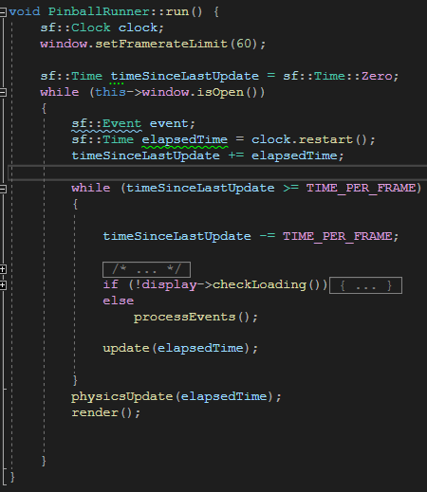
SFML can limit the speed at which the window created runs at by using the setFramerateLimit() function. This limits the fps to 60 even when outside the second while loop which forces whatever put inside it to run at 60 fps. This way, the FPS is uniform.

Slide 9
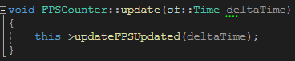
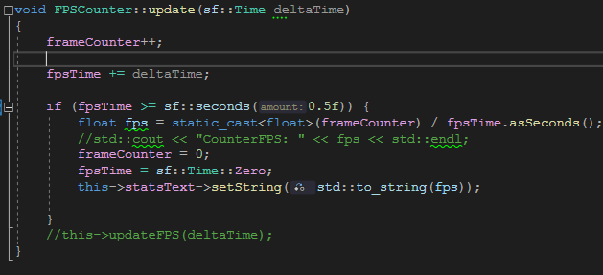
This is how the FPS is calculated. Every 0.5 seconds, the fps is displayed on the screen.

Slide 10
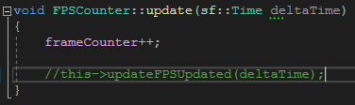
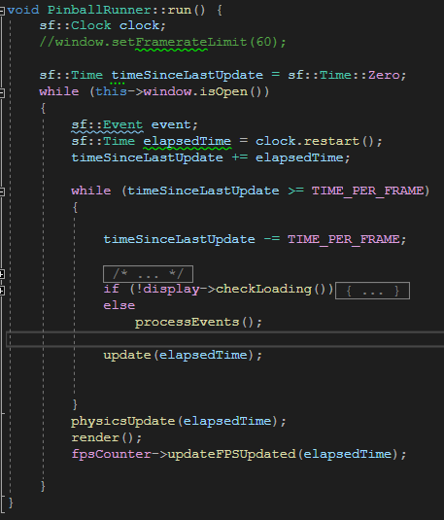
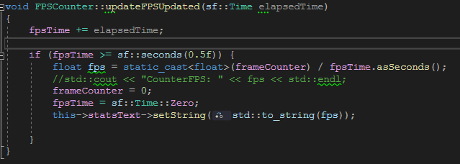
An alternative way to calculate FPS without using setFramerateLimit(). It shows that the second while loop runs at 60 fps even if the first while loop runs on different speeds due to computer specs

Slide 11
Pinball project source/credits
https://github.com/dinismf/cpp_pinball.git

Slide 12
Github link
https://github.com/Janarci/P2.git

